Slide 1


Walmart A Comprehensive Analysis
Key Trends, Uncovering Customer Preferences, and Offering Strategic Recommendations for Enhanced Business Performance
Verda Batool

Slide 2

OBJECTIVE
The objective of this project was to conduct an extensive Exploratory Data Analysis (EDA) on a Walmart Sales Data dataset to uncover insights into
Sales Performance,
Customer Behavior,
Product Line Profitability,
Payment Method Preferences, and
Temporal Sales trends

Slide 3
TYPES OF QUESTIONS ANSWERED
Identify patterns in sales across different cities and branches.
Understand customer demographics and their purchasing habits.
Evaluate the performance of various product lines.
Assess the impact of different payment methods on sales.
Determine peak sales periods and understand how these vary by time of day and day of the week.
Explore key business terms such as revenue, cost of goods sold (COGS), gross income, VAT, and customer loyalty.

Slide 4

TARGETED ANALYSIS
Exploratory Data Analysis
Sales Performance Analysis
Customer Behavior Analysis
Product Line Insights
Payment Method Analysis
Time Based Sales Analysis

Slide 5
ABOUT THE DATASET
6 Unique Product Lines
Electronic accessories
Fashion accessories
Food and Beverages
Health and Beauty
Home and lifestyle
Sports and travel
Timeline
January 2019 – March 2019
Three Distinct Cities
Yangon
Naypyitaw
Mandalay

Slide 6
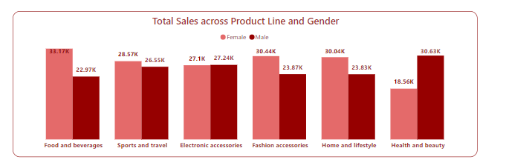
Product Line | Total Sales ($) | Percentage
Food and Beverages | 56,144.84 | 17.38%
Sports and Travel | 55,122.83 | 17.07%
Electronic Accessories | 54,337.53 | 16.82%
Fashion Accessories | 54,305.9 | 16.81%
Home and Lifestyle | 53,861.91 | 16.68%
Health and Beauty | 49,193.74 | 15.23%
TOP SELLING PRODUCT LINE
Food and Beverages is the top selling product line contributing to 17.38% of the revenue followed by Sports and Travel and Electronic accessories.
PRODUCT PREFERENCE BY GENDER
Health and Beauty is the top performing category among males followed by Electronic accessories
Food and Beverages is the top performing category among females followed by Fashion accessories

Slide 7
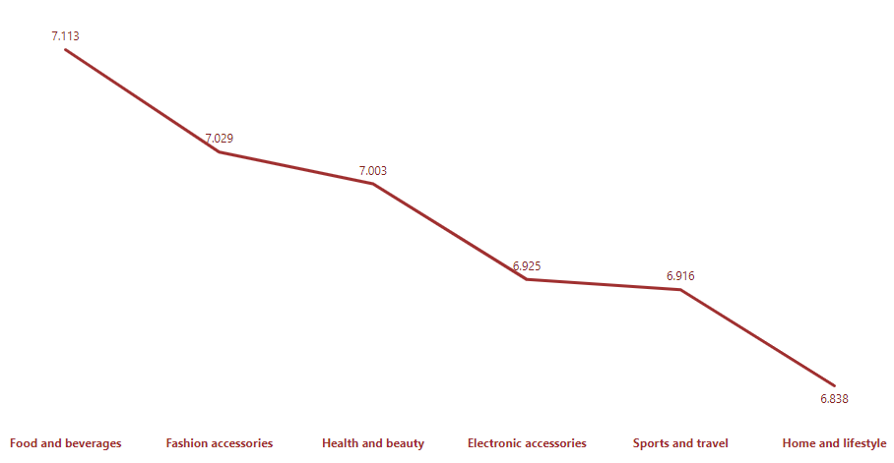
AVERAGE RATING ACROSS PRODUCT LINES
Food and Beverages has the highest overall rating (7.11).
Fashion accessories has the average rating of (7.02)
Health and beauty has the average rating of (7.00).
Electronic Accessories has the average rating of (6.92).
Sports and Travel has the average rating of (6.91).
Home and Lifestyle has the lowest overall average rating of 6.83.
TOP PERFORMER
Food and Beverages has the highest overall rating (7.11).
AREAS FOR IMPORVEMENT
Home and Lifestyle has the lowest overall average rating of 6.83.
Average Rating per Product lines

Slide 8
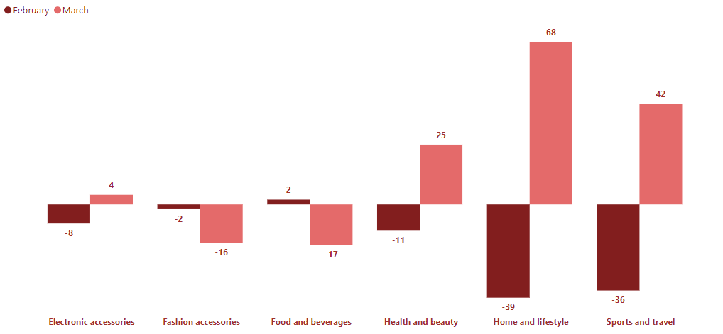
MOM SALES GROWTH % ACROSS PRODUCT LINES
Home and Lifestyle has the highest MOM growth in sales with the 68% increase in March. Sports and travel increased sales by 42% in March. Health and Beauty increased sales by 25% in March.
Food and Beverages and Fashion accessories had the sales declined by 17% and 16% respectively.
MOM growth across all categories is 12.59%
MOM Growth% across Product lines

Slide 9
MOM SALES GROWTH % ACROSS PRODUCT LINES
Home and Lifestyle has the highest MOM growth in sales with the 68% increase in March.
Sports and travel increased sales by 42% in March.
Health and Beauty increased sales by 25% in March.
Electronic Accessories increased sales by 4% in March.
Food and Beverages and Fashion accessories had the sales declined by 17% and 16% respectively.
TOP PERFORMERS
Home and Lifestyle has the highest MOM growth % in sales with the 68% increase in March.
Sports and travel increased sales by 42% in March.
AREAS FOR IMPROVEMENT
Food and Beverages and Fashion accessories had the sales declined by 17% and 16% respectively.

Slide 10
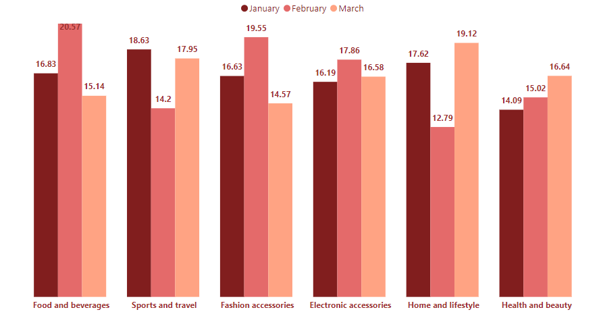
TOTAL SALES ACROSS PRODUCT LINES AS %AGE OF TOTAL SALES PER MONTH
Total Sales across Product Lines (as a percentage of total sales per month)

Slide 11
TOTAL SALES ACROSS PRODUCT LINES AS %AGE OF TOTAL SALES PER MONTH
In January,
Sports and Travel was the top performing product line contributing to 18.63% of the month’s revenue.
Health and Beauty was the least performing category contributing to 14.09% of the month’s revenue.
In February,
Food and Beverages was the top performing category contributing to 20.57% of the total revenue.
Home and Lifestyle was the least performing category contributing to 12.79% of the month’s revenue.
In March,
Home and Lifestyle was the top performing product line contributing to 19.12% of the month’s revenue.
Fashion Accessories was the least performing category contributing to 14.57% of the month’s revenue.

Slide 12
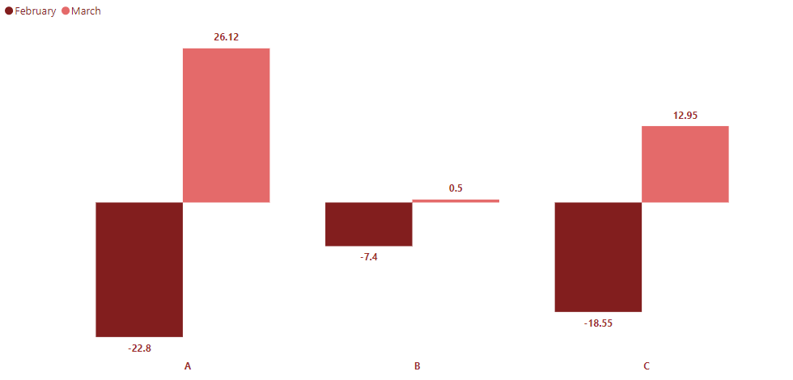
MOM SALES GROWTH % ACROSS BRANCHES
Branch A and Branch C have 26.12% and 12.95% growth in their sales, hence being the Top performers. It means that branch A and C has the potential to grab more sales.
Branch C had 0.5% increase in sales and is the area for improvement.
MOM Growth% across all branches

Slide 13
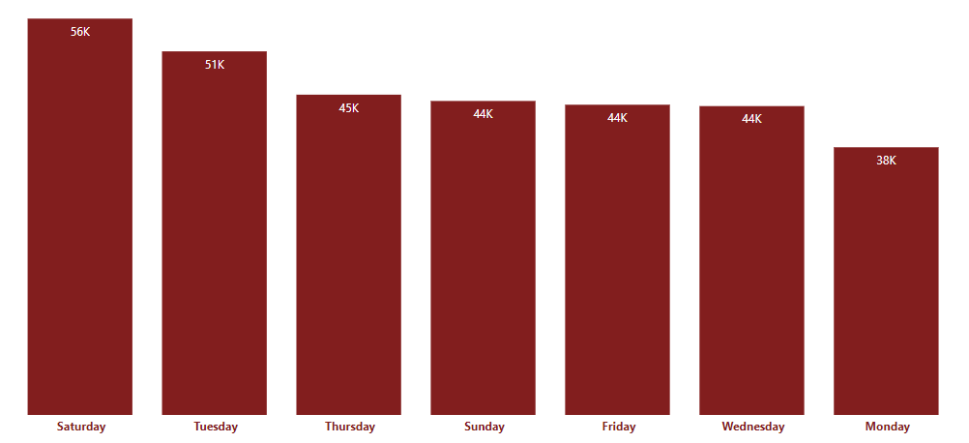
SALES ACROSS DAYS OF THE WEEK
Sales throughout Week

Slide 14

SALES ACROSS DAYS OF THE WEEK
Most of the sales are taking place on Saturday followed by Tuesday and Thursday.
Males: Males prefer to shop the most on Saturday.
Females: Females prefer to shop on Tuesday.
Monday is the least desirable day for shopping by the customers.
Sales across time of the day
SALES ACROSS TIME OF THE DAY
Most of the sales are taking place during Afternoon.
Mornings are the least desirable times for shopping by the customers.

